Slide 1
The Titus Family Trip Around the World
By: Charles Titus, MPA
GEOG101 I014 Fall 14:
GEOG101 Introduction to Geography
American Public University System

Slide 2
Why this trip?
When planning on a trip to take, I have to take into consideration my interest as well as my wife's interest. The majority of my interests are political. I enjoy getting hands on experience when looking at political matters of other countries. When looking at my wife's interest, she loves anything to do with wildlife or marine biology. She is even a high school biology teacher. These things combined is why I chose the stops on my trip. Two of the places will be things that I enjoy doing and the other two are things that my wife will enjoy doing.

Slide 3
4
3
Trip to Ukraine, Poland, and Moldova
Trip Stops:
1. Border Issue – Crimean Peninsula
2. Local Culture – Gagauzia, Moldova
3. Capital City – Kiev, Ukraine.
4. Landform – San River
2
1

Slide 4
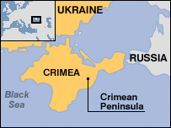
Crimean Peninsula (Border Issue)
The reason why I chose the Crimean Peninsula is because I enjoy following all of the current events that are happening around the world. The Crimean Peninsula is currently one of the political issues that I have followed very closely over the past year.
Photo from: Houle, 2014.

Slide 5
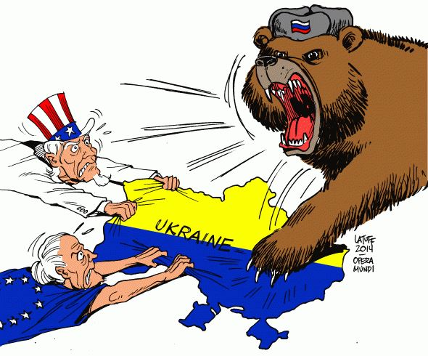
What exactly is the border issue?
The border issue is who is going to control the Crimean Peninsula. Russia earlier this year annexed the Crimean Peninsula as part of Russia. The reason is because “Putin called the events in Ukraine an illegal coup and ordered troops into Crimea” (Kim, 2014).
Photo from: Woods, 2014.

Slide 6
What is at stake in the issue?
What is at stake in the issue is who is going to control Crimean Peninsula. There are many countries that are involved such as Ukraine, Russia, many nations in the EU and even the United States. Simon (2014) found that even months after it was annexed by Russia, most nations still considered the Crimean Peninsula as a part of Ukraine. However, it is clear to see that Russia is the one that is currently dominating the Crimean Peninsula.

Slide 7
What is the current status of the issue?
The current status of the issue is that Russia is the one dominating the Crimean Peninsula. Currently the United States and the European Union have worked together to possibly put in place tougher economic sanctions including sanctions on the energy section (Mason & Kelly, 2014).

Slide 8
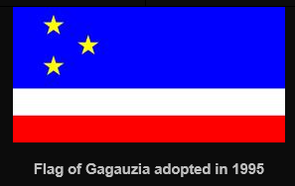
Gagauzia, Moldova (Local Culture)
The reason why we have chosen this stop is because my wife enjoys studying cultures and environments around the world. So, to keep her happy I picked this stop for her. This way I can make sure on the plane trip back, she is talking to me.
Photo from: Andersen, 2005.

Slide 9
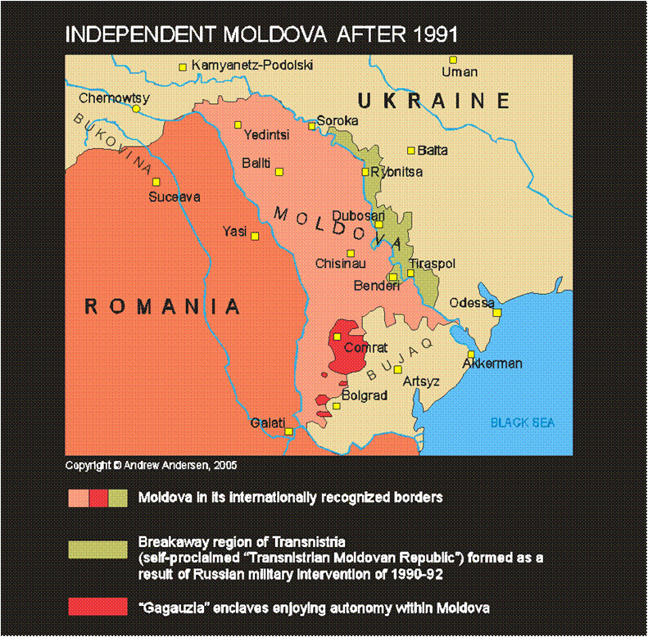
Describe the specific local geographic area in which this culture is found
The Gaguaz language can be found in a part of Moldova. The majority of the people that live in Gagauzia speak the Gaguaz language. Gagauzia is located in southern Moldova (Khan, 2008).
Photo from: Andersen, 2005.

Slide 10
What traits and practices make this culture distinct unique?
One of the practices that make this culture unique is their view on joining the EU. The majority of the country of Moldova voted to join the EU. However, the people of Gagauzia voted against the joining of the EU (Rinna, 2014).

Slide 11
How is this culture connected to the geographic landscape where it is found?
When looking at the Gagauzia people it is important to point out that 80% of the people that live in Gagauzia speak the Gaguaz language. They are connected because the majority of the people that live in this area are of the Gaganzia culture and speak the Gagauzia language (Rinna, 2014).

Slide 12
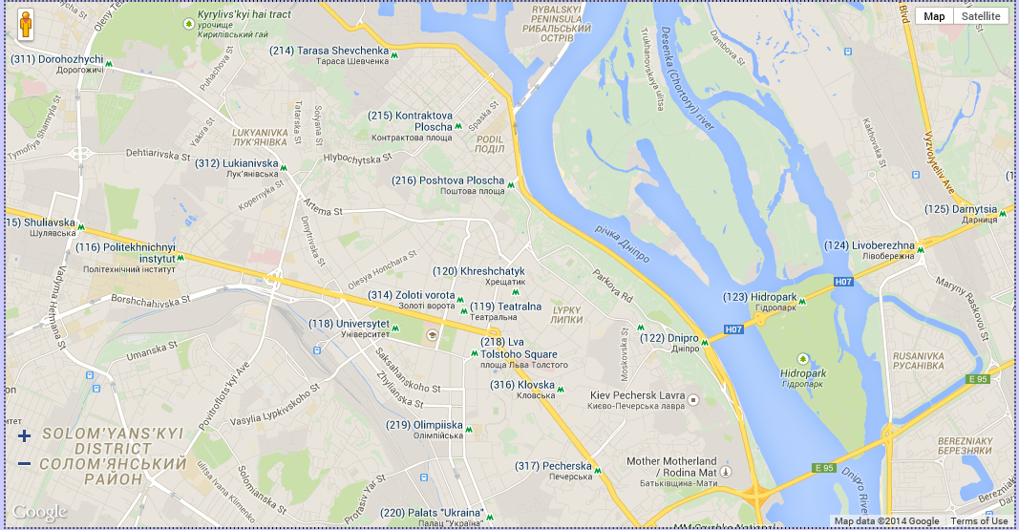
Kiev, Ukraine (Capital)
Map of the city of Kiev:
The reason why I have chosen Kiev, which is located in Ukraine, is because I love to study other countries political atmosphere. I have a B.A. in Political Science and a Master’s degree in Public Administration. I have always loved to study anything that has to do with these two topics.
Photo from: Map of Ukraine, 2014).

Slide 13
Site
Kiev is the capital of Ukraine. Kiev is located on the Dnepr River and has an estimated population of 3 million people (Optima Tours, 2014). Kiev has a very long history and “the golden age of Kiev falls on the 11th-12th centuries, when Kiev Rus was a powerful state, the center of trading routes between the Baltic and the Mediterranean.” (Optima Tours, 2014). It was founded on the Dnepr River which allowed it to use the river to receive and ship goods.

Slide 14
Situation
The situation of Kiev is very important to understand. De Blij, Muller, Nijman (2012) pointed out that Ukraine “has access to international shipping lanes, a large resource base, massive farm production, educated and skilled labor, and a large domestic market” (p. 99). One of the shipping lanes is that of the Dnepr River in which Kiev is located. By understanding this one can see that Kiev and Ukraine as a whole trade with many countries in Europe. As for communications, Ukraine is wanting to join the European Union. Thus meaning that it does have communications with the countries that are a part of the EU.

Slide 15
What makes this city unique, culturally and/or physically?
What makes this city so unique is that it is really old. Kiev is 15 centuries old where it started out as “an ancient settlement of nomadic tribes to one of the largest cities in the world” (Optima Tours, 2014). Kiev is also known as the mother of the Slavic cities (Optima Tours, 2014).

Slide 16
What sort of people live there/go there?
The official language of Kiev is Ukrainian. Which is based off of a Slavic language (Optima Tours, 2014). When looking at the population it was hard to find just the population of Kiev. However, the population of Ukraine as a whole is about 75% ethnic Ukrainian and the largest minority group is Russians at about 20% (Morris, 2014).

Slide 17
Major economic activities?
Kiev is a considered to be the leading industrial center of Ukraine. When looking at the economic activities it is important to look at the major industries of this Kiev which include large food processing, the manufacture of machinery and tools, building materials, and textiles (Optima Tours, 2014). As a result of all of these industries you will find many “new office centers, banks, trade exhibition centers and other commercial enterprises” (Optima Tours, 2014).

Slide 18
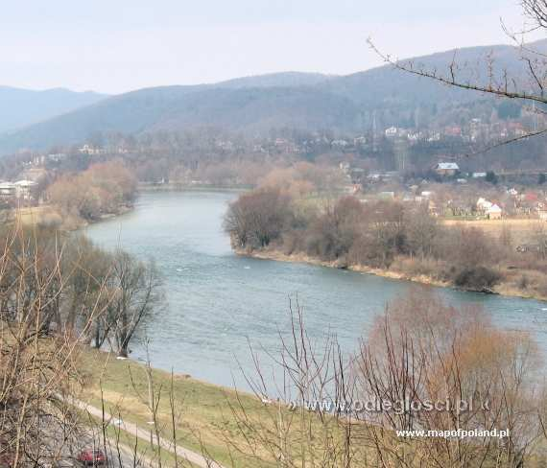
San River (Landform)
The reason why we chose to visit the San River is for my wife. Although I could have picked somewhere I would have enjoyed I do like being married. So, we picked this place that way my wife can observe the wildlife that would be present here.
Photo from: Ćmakowski, 2011.

Slide 19
What exactly is the landform?
For the Landform that we would visit it would be San River. It is distinct because they built a dam on it to help keep it from flooding. San River is a river that is in Poland that has an estimated length of over 440 km (Lucas, 2013). San River flows into Ukraine.

Slide 20
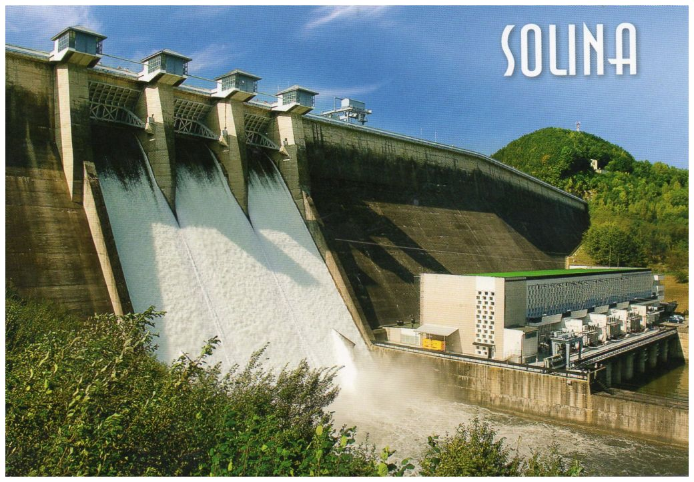
What major Human-Environment Interaction(s) (HEI) is going on with the landform today?
The Human-Environment Interaction that is taking place on the river is the Solina Dam that was built. The Solina Dam resulted in the largest artificial lake in Poland to be formed which is known as Lake Solina. The dam generates power for the people that live near it (Triposo, 2014).
Photo from: Hedonic, 2011.

Slide 21
Who are the people/companies/governments involved in this HEI?
The companies that are involved in the HEI is PGE Energia Odnawialna S.A., DHV Hydroprojekt, and the country of Poland (DHV Hydroprojekt, 2014). These three work together to run the Solina Dam.

Slide 22
More information that is needed:
In my wife and my case the best time of year for us to go would be in the month of July. My wife is a high school teacher and has the entire month of July off each year. Thus making it the best time of year for us to go.
Before we go I would like to research to make sure that there is not a civil war going on in Ukraine. This way I am not putting my wife or myself in any danger.
As for food we would want to experience the lifestyle that we are visiting and would want to eat what the native people of the region eat. We have done this every where we have visited and it has always worked out good for us.

Slide 23
References
Andersen, Andrew. (2005). Gagausia. UNPO. Retrieved December 8, 2014 from http://www.conflicts.rem33.com/images/moldova/gagauzia.htm
Ćmakowski, Tomasz. (2011). The San River - Sanok Pictures. Map of Poland. Retrieved December 8, 2014 from http://www.mapofpoland.net/Sanok,photo,2330,The-San-River.html
De Blij, H., Muller, P., & Nijman, J. (2012). GEOGRAPHY: REALMS REGIONS, AND CONCEPTS (15th ed.). John Wiley & Sons.
DHV Hydroprojekt. (2014). Rehabilitation and Modernization of the Solina Dam. Retrieved December 6, 2014.
Hedonic. (2011). Postcards – Hedonic. Retrieved December 8, 2014 from http://hedonic- postcards.blogspot.com/2012_07_01_archive.html
Houle, David. (2014). Monthly Macro: Baby It’s Cold Outside. Season Investment. Retrieved December 8, 2014 from http://www.seasoninvestments.com/insights/monthly-macro-baby-its-cold-outside/
Khan, Razib. (2008). Origins of the Gagauz people: a Turkish Dynamic. Discover. Retrieved December 6, 2014 from http://blogs.discovermagazine.com/gnxp/2008/12/origins-of-the-gagauz-people-a-turkish-dynamic/
Kim, Susanna. (2014). What’s Going On Between Russia and Ukraine? ABC News. Retrieved December 6, 2014 from http://abcnews.go.com/International/refresher-happening-ukraine-russia/story?id=24605042

Slide 24
References Continued
Kim, Susanna. (2014). What’s Going On Between Russia and Ukraine? ABC News. Retrieved December 6, 2014 from http://abcnews.go.com/International/refresher-happening-ukraine-russia/story?id=24605042
Lucas, J. (2013). River San. Pioneer Flyfishing Poland Ltd. Retrieved December 6, 2014 from http://fish.pl/?page_id=2
Map of Ukraine. (2014). Map of Kiev. Retrieved December 8, 2014 from http://www.mapofukraine.net/kyiv/map_of_kiev.html
Mason, Jeff & Kelly, Lidia. (2014). U.S., EU to Work Together on Tougher Russia Sanctions. Reuters. Retrieved December 6, 2014 http://www.reuters.com/article/2014/03/26/us-ukraine-crisis-idUSBREA2P0VB20140326
Morris, Jamie. (2014). Ukraine - Language, Culture, Customs and Etiquette. Kwintessential Ltd. Retrieved December 6, 2014 from http://www.kwintessential.co.uk/resources/global-etiquette/ukraine.html
Optima Tours. (2014). Welcome to Kiev. Retrieved December 6, 2014 from http://www.kiev.info/about/index.htm
Rinna, Tony. (2014). Moldova, the EU and the Gagauzia Issue. New Eastern Europe. Retrieved December 6, 2014 from http://neweasterneurope.eu/interviews/1097-moldova-the-eu-and-the-gagauzia-issue
Simon, Scott. (2014). Half-Year After Takeover, Russia Controls Crimea. NPR. Retrieved December 6, 2014 from http://www.npr.org/2014/10/11/355340412/half-year-after-takeover-russia-controls-crimea
Triposo. (2014). Solina Dam. Retrieved December 6, 2014 from http://www.triposo.com/poi/Solina_Dam
Woods, Alan. (2014). Russia, Ukraine and the West: Will there be war? Marxism. Retrieved December 8, 2014 from http://www.marxist.com/russia-ukraine-and-the-west-will-there-be-war.htm

